Slide 1
HOTEL MANAGEMENT SYSTEM USING MONGO DB
R V S TEJA KRISHNA(17MIS7085)
P H S ABHIRAM(17MIS7073)

Slide 2
INTRODUCTION
Our project on Hotel management system gives idea about the management in hotels.
Gives all the information regarding check in or check our facilities of the customer.
The customer can make his or her booking for room and food.
The project provides the facility of searching the customer in that particular hotel.

Slide 3
ADVANTAGES
Huge reduction in number of pages being used for the data storage.
Back up facility provided in case of data loss.
Reduction in cycle time till the updated data will be available.
Speedy retrieval of data.
Compatible with the advance versions for future perspectives.
Cost benefits

Slide 4
TECHNOLOGIES USED
To build this project we have used Netbeans to develop the front-end in java
To store the data of the customer we used Mongo DB in the backend.

Slide 5
SYSTEM DESIGN

Slide 6
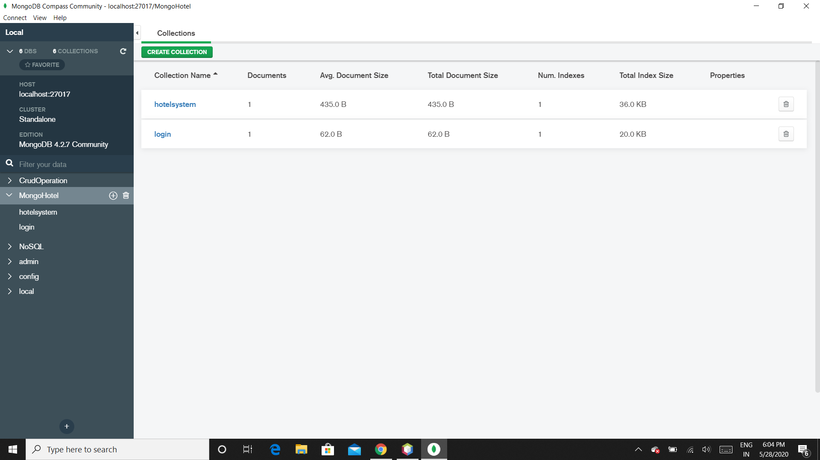
COLLECTIONS IN DATABASE

Slide 7
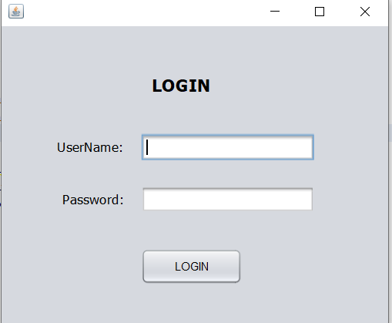
LOGIN PAGE

Slide 8
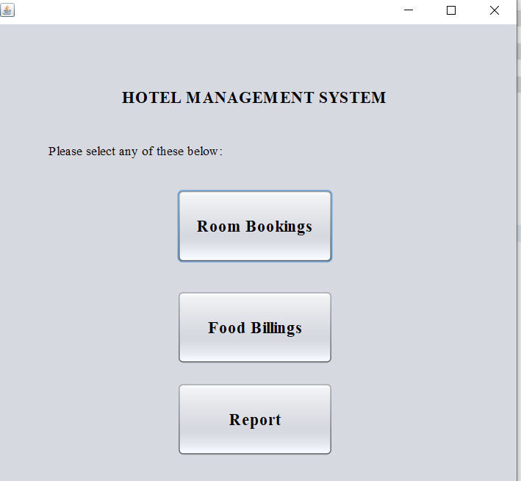
HOME PAGE

Slide 9
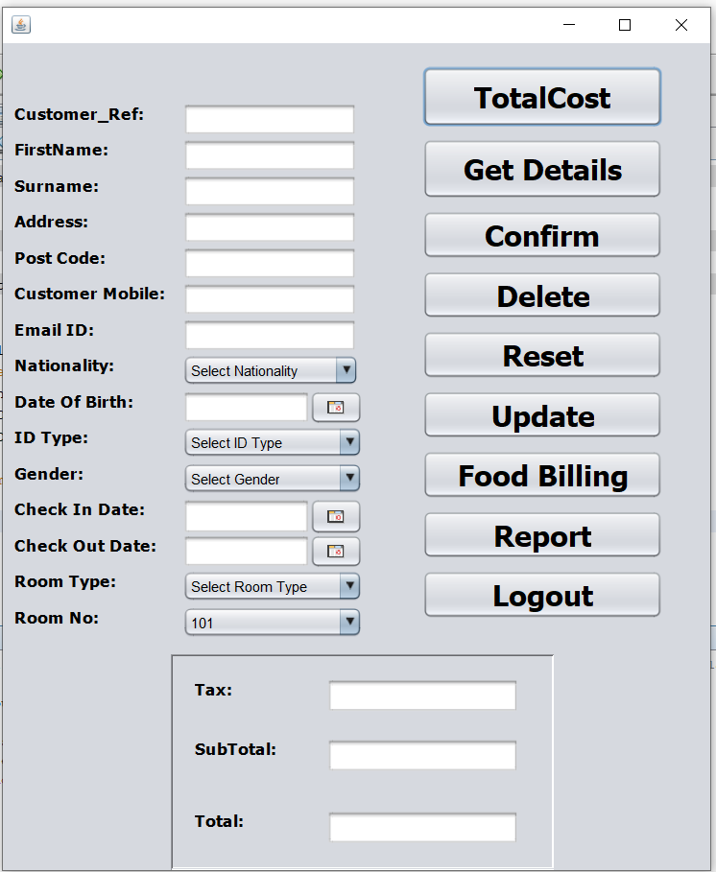
ROOM BOOKINGS PAGE

Slide 10
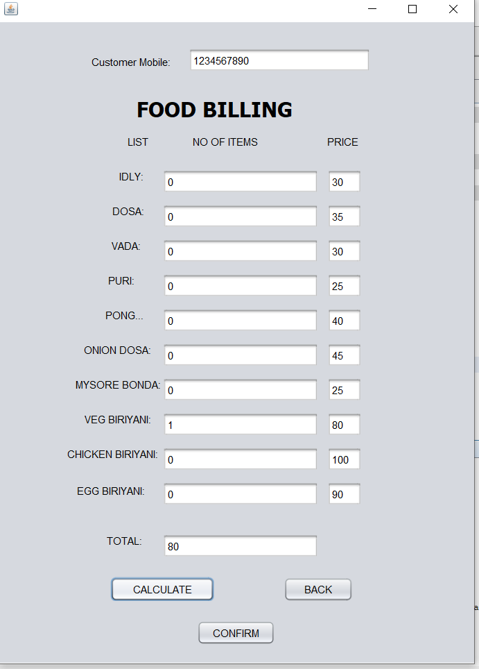
FOOD BILLINGS PAGE

Slide 11
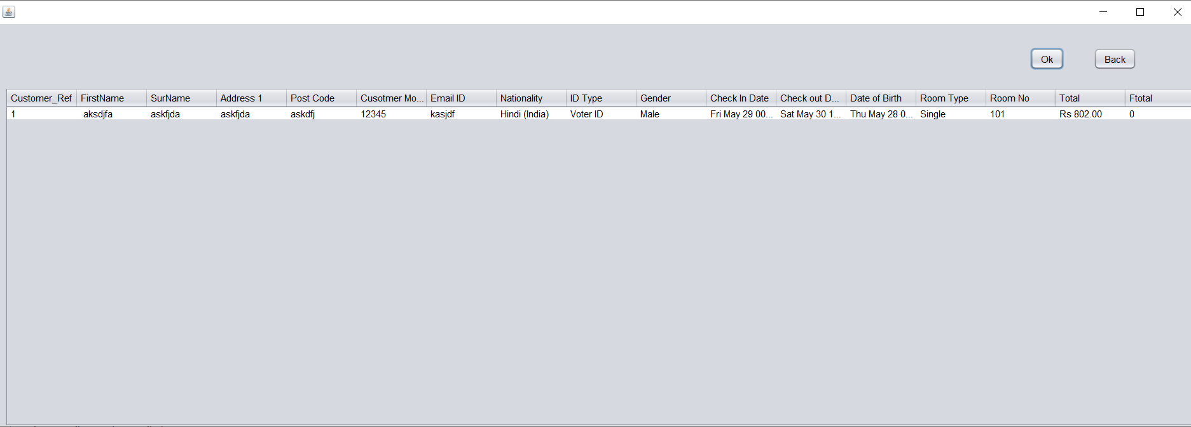
REPORTS PAGE

